Slide 1

Coalition of Weather Bois
(Cow-bois)
Topic: Conceptual Design Review
Members:
Gantzen Miller
Kennedy Jones
Pete Ozegovic
Ben Rogers
Christian Evans
Abdullah Ali
Notes:
Gantzen Introduces Group

Slide 2

Problem Statement
The KSU Mesonet uses weather stations that are +$19,000 to make. I believe we can cut down cost significantly and make a smaller system that can be used as a main station or a micro-station
Great Significance in:
    Cheaper system
    Smaller System
    Custom System (not having to rely on outside sources)
Notes:
Gantzen
Discusses Problem Statement and Solution
Also Discuss the great significance in what the weather stations do and what our project offers

Slide 3
Requirements
ID | Project Requirement | Description
1.0 | Cost Efficiency (<$19,000) | We plan to shoot for a range of $600 - $800
2.0 | Wireless Transmission of Data Distance being >= 410 Miles | We need to be able to transmit data values to a server across Kansas
3.0 | Easily replaceable sensors (Convenient maintenance) | Plug and unplug approach incase something breaks, it should be easy to change the sensor
4.0 | Off Grid Power Capabilities in a remote area | Needs to be a self-sustaining system and be able to power and charge itself
5.0 | Size maximum (1.5ft x 1.5ft x 1.5ft) | Overall maximum size that was mentioned to be a maximum (cooler sized)
5.1 | Size minimization | Though we have a maximum, we should shoot for a smaller compact system
6.0 | Sensor Accuracy | Following Page
Notes:
Gantzen
Go through the measurable requirements

Slide 4
Requirements (Sensors)
ID | Sensor | Accuracy
6.1 | Temperature | ~0.3°C - ~0.4°C
6.2 | Humidity | ~2% - ~3%
6.3 | Solar Radiation | ~5% (Resolution 0.2 W/m^2)
6.4 | Wind Speed Wind Direction | ~0.3 m/s ~3°
6.5 | Precipitation | ~1% - ~5% (Resolution 0.254mm)
6.6 | Air Quality | N/A
6.7 | Pressure | ~1mb
Notes:
Gantzen
Discuss the specifics of the sensors
Not hard set requirements

Slide 5
Standards Followed
Standard Name | Description
TTL (Transistor – Transistor Logic) Level Voltage | Our sensors run on a 5V Power and data transmission system
Inter-Integrated Circuit Bus (I2C Bus) | De facto industry standard for short-distance serial communication between ICs
FCC Compliance with Wireless Transmission | Making sure the modem purchased is FCC pre-certified
Stemma QT JST connectors* | Standard developed by Adafruit to make I2C Connections easier
3GPP (3rd Generation Partnership Project) | International standards for 2G, 3G, 4G, 5G, and LTE communication
Notes:
Gantzen
Discuss some general standards that are followed in the project

Slide 6
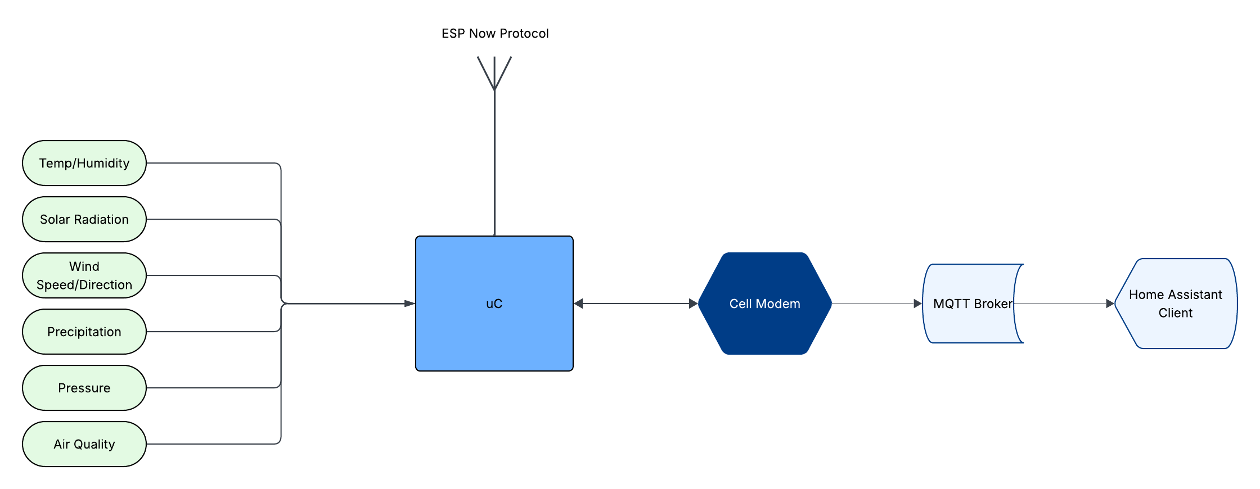
Block Diagram of System
Notes:
Gantzen
Self explanatory

Slide 7
Decision Matrix Sensor Purchases
( 1 – 5 ) 1 is worst, 5 is best | Adafruit Temp and Humidity | AdaFruit Temp, Humidity, Pressure | Ada fruit Temp | Solar radiation | Ambient Light | Soil Temp and Moisture | Adafruit soil temp | Adafruit Air Quality | Adafruit Air Quality stemma
Price | 3 | 2 | 4 | 1 | 4 | 3 | 5 | 2 | 4
Durability | 3 | 3 | 3 | 3 | 3 | 5 | 2 | 3 | 3
Accuracy | 3 | 1 | 4 | 5 | 5 | 5 | 2 | 3 | 2
Connectivity | 5 | 5 | 5 | 2 | 2 | 5 | 5 | 5 | 5
Combination | 3 | 5 | 2 | 1 | 1 | 5 | 5 | 1 | 1
Total Score | 17 | 16 | 18 | 12 | 15 | 23 | 19 | 14 | 15
Notes:
Kennedy – Discuss decision matrix and what sensors were chose and why

Slide 8

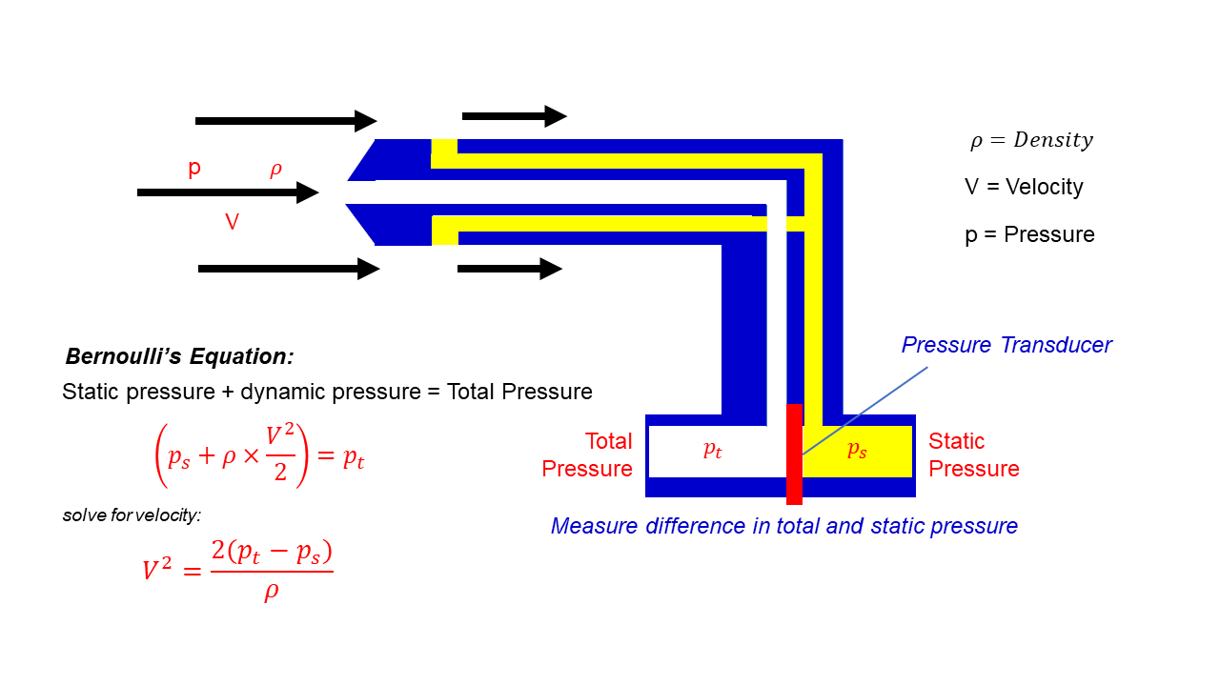
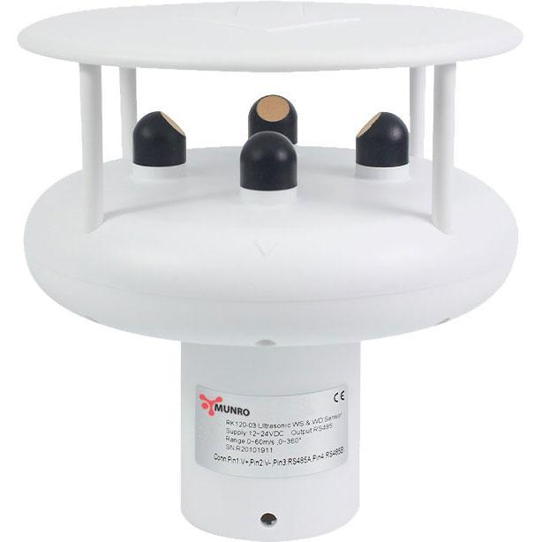
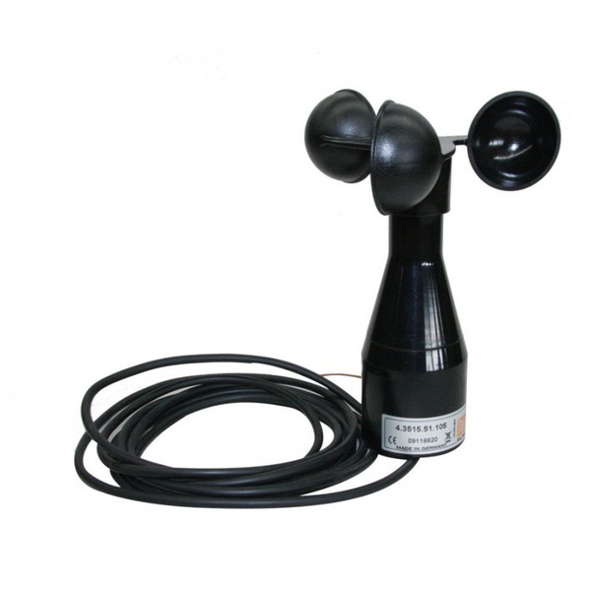
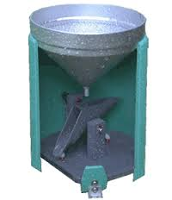
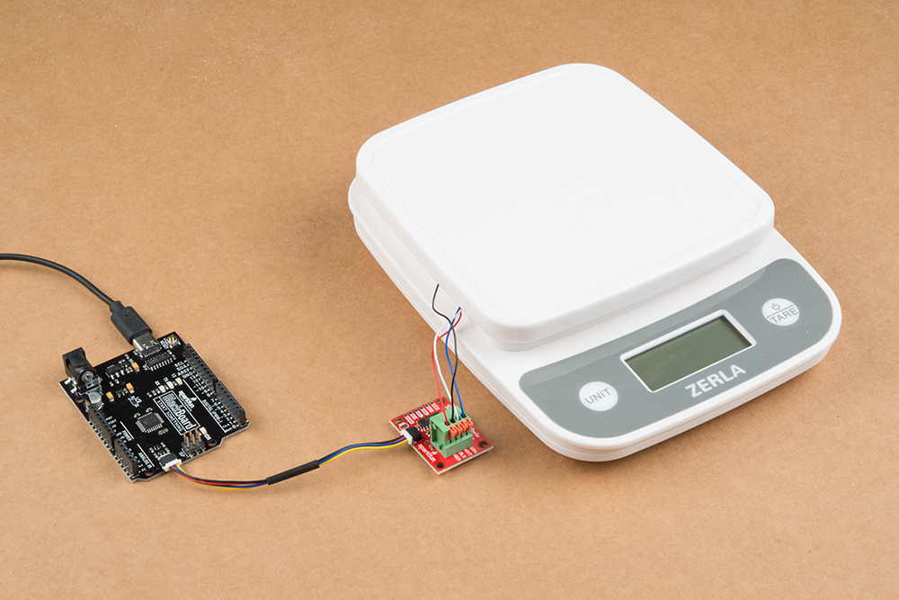
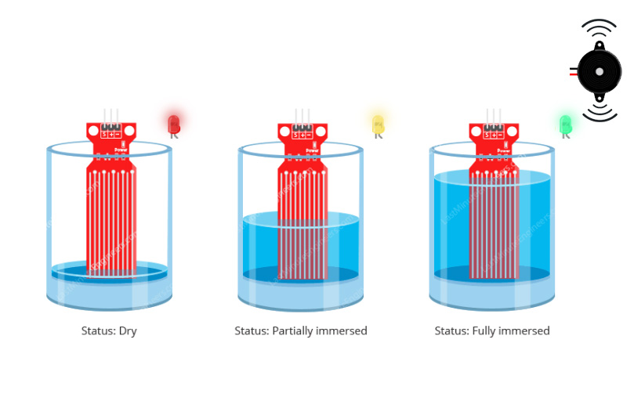
Decision Matrix Sensor Build Types
Criteria | Description | Importance (1-5 scale) | Pitot Tubes in an X | Sonar Anemometer | Ping Pong Ball Anemometer and fin | Seesaw with weight sensors | Scale with water dump method | Liquid Level Sensor
Feasibility | Is it even possible? | 5 | 3 | 2 | 5 | 3 | 4 | 4
Budget | Does the design fit our budget? | 5 | 3 | 2 | 3 | 4 | 4 | 3
Durability | Will it break easier due to elements? | 3 | 5 | 5 | 3 | 4 | 3 | 4
Accuracy | Will it accurately read what we need? | 4 | 4 | 5 | 3 | 4 | 4 | 4
Total |  |  | 61 | 55 | 61 | 63 | 65 | 60
Notes:
Gantzen
Discussion of different design approach and explain why we are choosing designs rather than purchasing them straight up

Slide 9
Decision Matrix Modem Types
Criteria | Description | Importance (1-5 scale) | Notecard Cellular LTE Cat-1 | Quectel BG95 | LILYGO T-SIM7600G-H R2
Feasibility | Compatibility with planned sensor setup | 5 | 4 | 4 | 5
Integration | Ability for integration with ESP32 and I2C | 4 | 4 | 3 | 5
Capabilities | 4G LTE capability | 5 | 5 | 5 | 5
Power Consumption | Does the modem draw an unreasonable amount of power? | 4 | 4 | 4 | 4
Budget | <$200 Price | 5 | 4 | 5 | 4
Total |  |  | 97 | 98 | 106
Notes:
Ben: discuss modem types (going with the Lilygo) and discuss a little bit about it
Talk about SIM card we would need to buy – could do data calculations later

Slide 10
Decision Matrix Microcontroller Types
Criteria | Description | Importance (1-5 Scale) | ESP32-WROOM-32U | STM32F407 | RP2040
Feasibility | Can it handle sensors & wireless? | 5 | 5 | 4 | 3
Budget | Fits within project cost? | 4 | 5 | 3 | 4
Capabilities | Processing power, memory, I/O | 5 | 5 | 4 | 3
Integration | Ease of adding sensors & communication | 5 | 5 | 4 | 3
Reliability | Suitable for outdoor/long-term use | 3 | 4 | 4 | 3
Community Support | Libraries & documentation | 2 | 5 | 4 | 3
Total |  |  | 131 | 101 | 84
Notes:
The ESP32-WROOM-32U is the best choice because it's powerful, affordable, and has built-in WI-FI and Bluetooth.
It can easily handle multiple sensors, connects quickly, and has great library and community support for fast development.
Its external antenna also makes it reliable for outdoor use.

Slide 11
Power System Decision Matrix
Criteria | Description | Importance (1-5 scale) | Solar Panel and Battery Setup | Wind Turbine Generator | 3 Phase AC Integrated with Solar
Feasibility | Is it even possible? | 5 | 5 | 0 | 0
Budget | Does the design fit our budget? | 5 | 4 | 0 | 0
Efficiency | Is the design able to supply the needed power efficiently? | 4 | 3 | 5 | 5
Consistency | Is the design able to supply the needed power consistently? | 5 | 3 | 3 | 5
Total |  |  | 72 | 35 | 45
Notes:
Of these three designs, one is really even feasible off the get go with our budget and resources. While it would be nice to use a more efficient system with 3 phase power or a more efficient generation type such as a wind turbine, the cost of the supplies to implement would just exceed our entire budget for the rest of the project.

Slide 12
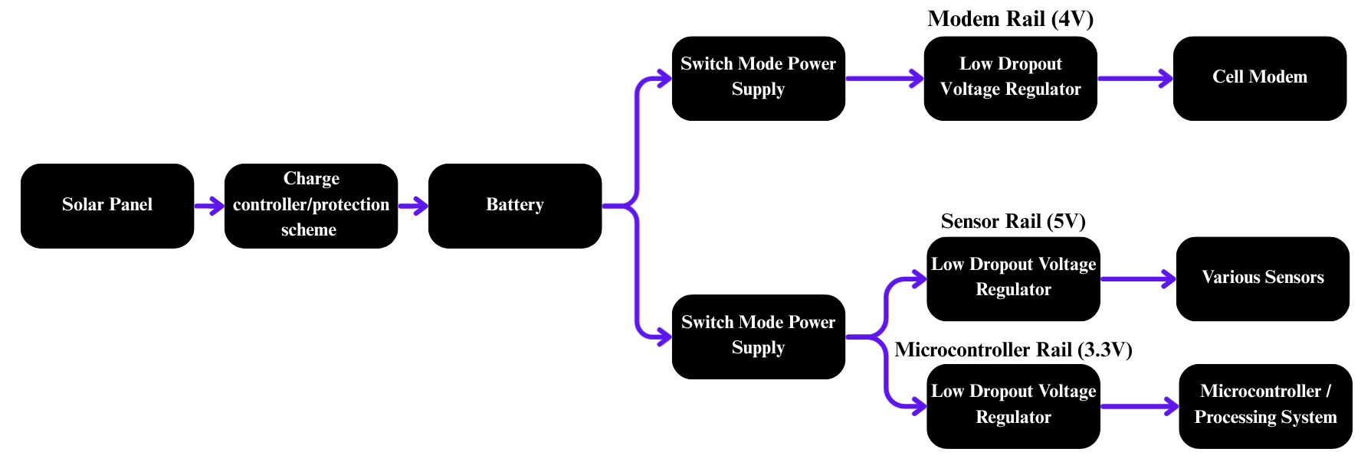
Power System Overview
Notes:
Christian
System Layout
- Solar Panel with Charge protection/control connected to a 12V battery. (capacity needs sizing)
- This will need to be able to control the current direction in and out of the battery for charging and discharging
- Battery Feeds 1-2 SMPS, most likely a buck convertor and a flyback convertor, flyback using two coils to split a 5V and a 3.3V rail for Sensors and microcontroller alike
- Modem draws most current in spikes. Will require a more robust convertor design that can handle varying current demands and more precise voltage bucking. (Will also need a duty cycle since the current draw will depend on if the modem is sending or in an idle state).
- Power distribution network will be constructed on a separate PCB for easy of safety measures and replacement in the future.

Slide 13
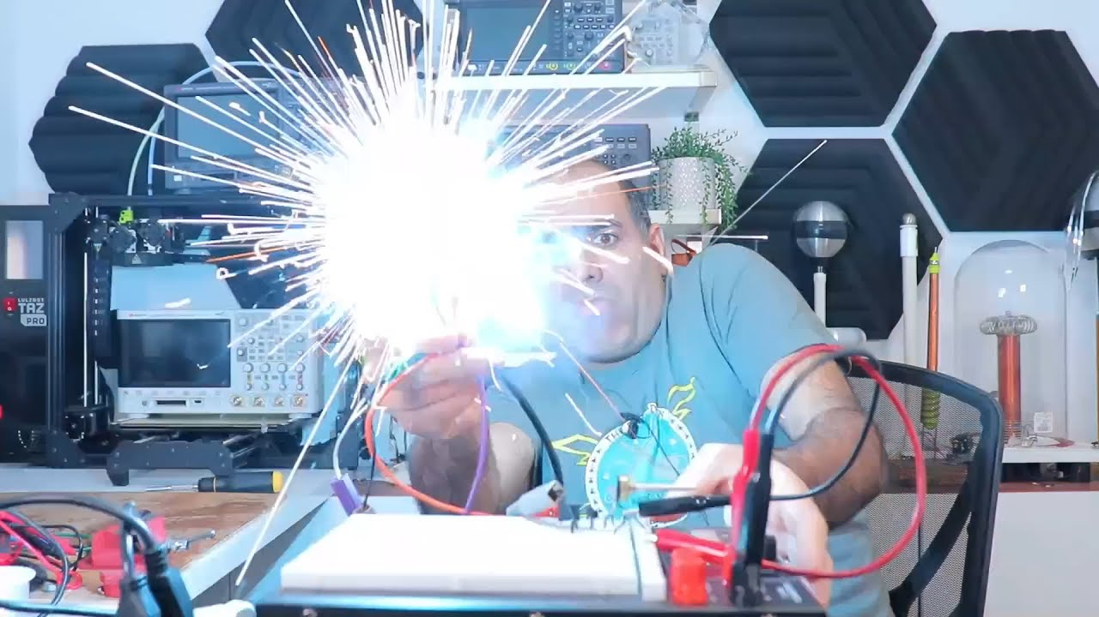
System Risk Analysis
Risk | Safety Measures | Responsibility
Insufficient generation/power in low generation periods (battery sagging) | Safety margin in power needs and battery capacity | Abdullah Ali
Overgeneration/Charging during unexpected extended peak hours | Charge Controllers and power protection relay system | Christian Evans
Cyber-attacks due to wireless transmission | IoT uses network servers, so there should be some general security overview for it | Ben Rogers
Notes:
Christian
One big risk we must plan for in advance is an insufficient power generation. We must size the battery and solar panel with a safety margin to avoid potentially harming the components of our system during power tight hours.
Another big risk is possible overgeneration. During the summertime, with extended daylight hours, we may have to handle a larger amount of generation than average. The implementation of a charge controller can help with this issue.
To ensure proper monitoring of both of these risks, we plan to add a relay system that can send battery and solar panel health information. We may also add a small emergency battery that can be used to send an SOS signal in case of a catastrophic power system error.
Since we are sending information over open air, security and encryption are important to prevent attacks on our system from unwanted sources. The current system has issues with unwanted users pinging the systems, an issue we would like to solve or mitigate at the very least.

Slide 14
Verification Matrix of Requirements
ID | Requirement | Verification Method
 |  | Analysis | Demonstration | Inspection | Test
1.0 | Cost Efficient | X
2.0 | Wireless Transmission Distance |  | X
3.0 | Convenient maintenance |  | X
4.0 | Off Grid Power |  |  | X
5.0 | Size maximum |  |  | X
5.1 | Size minimization |  | X
6.0 | Sensor Accuracy |  |  |  | X
Notes:
Gantzen
Here is our Verification Matrix (how we will measure each requirement parameter)

Slide 15
RACI Chart (Phase 1)
Task | Gantzen Miller | Kennedy Jones | Pete Ozegovic | Ben Rogers | Christian Evans | Abdullah Ali
Phase 1
Sensor Testing | A | R | C | I | I | I
Sensor Building | R | A | C | I | I | I
Programming Interface | I | C | R | A | I | I
Modem Setup MQTT Broker | C | I | A | R | I | I
Power Design Overview | C | I | I | I | R | A
Power Design Component Selection | C | I | I | I | A | R
Notes:
Gantzen
Here is our RACI Chart (how we will design who is responsible for what)
Flows right into our Gantt Chart

Slide 16
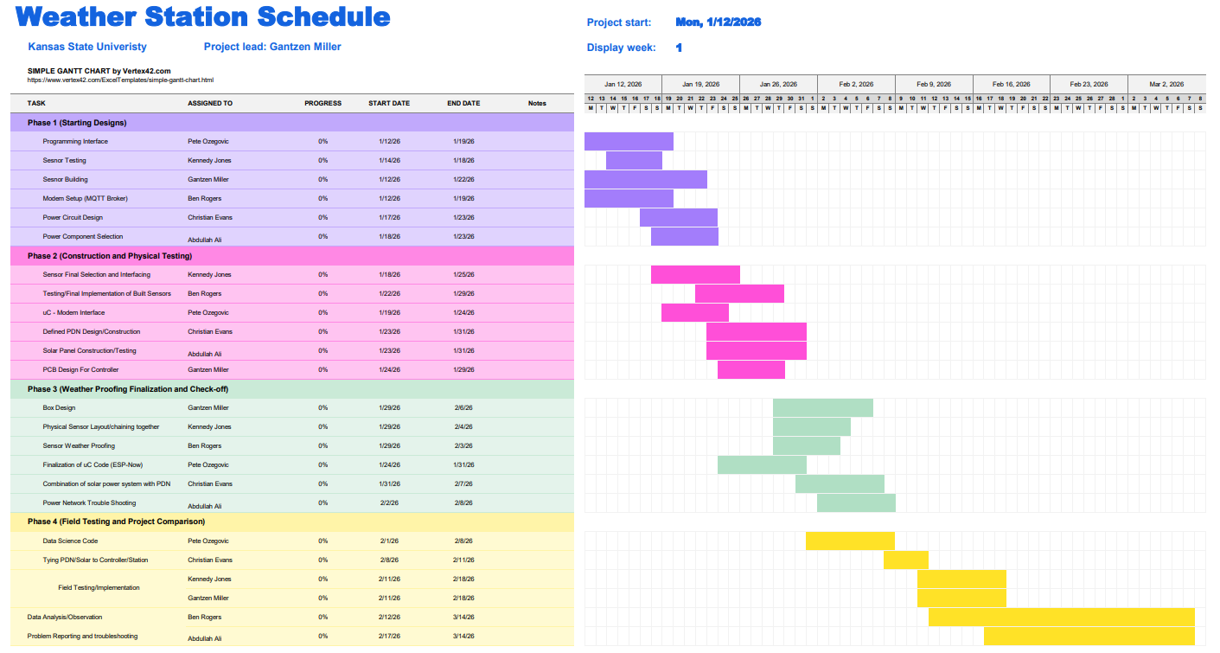

Slide 17
Questions?

